Slide 1


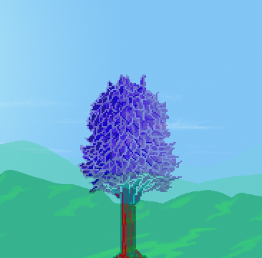

α
+
–

Slide 2
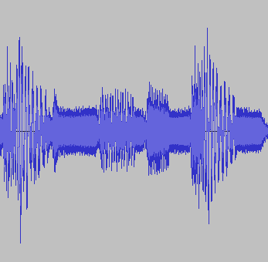

Slide 3
–
( O )
+

